Slide 1
WomenTechWomenYes Annual Gala
Let’s gather emails and fill the event!
Katie Huang, Aaron Barela, Amy Butler, Will Moore
Jan 8th, 2020

Slide 2

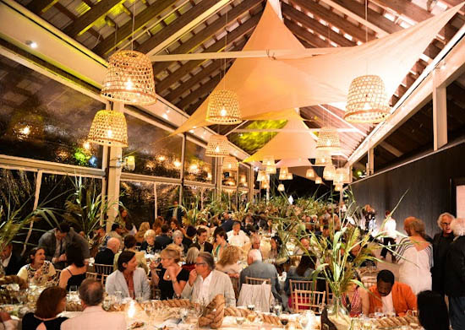
Goal
Build up email list
Gather engaged audience
Notes:
The goal is to build up your email list and get an engaged group out to attend your gala. We’re going to give you suggestions for station locations and times that we think will yield great results for your street teams.
Photo: https://hamptonsarthub.com/
Get the Women Tech Women Yes street teams maximum engagement with target audience for fundraising effort.
I feel like fundraising is always implied with these types of events/organizations. Though the pretend email we were given didn’t mention.----AB WomenTechWomenYes (WTWY) has an annual gala at the beginning of the summer each year. As we are new and inclusive organization, we try to do double duty with the gala both to fill our event space with individuals passionate about increasing the participation of women in technology, and to concurrently build awareness and reach.

Slide 3
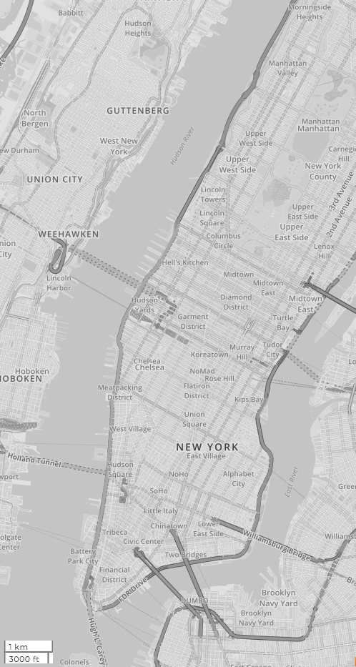
Methodology
Where?
When?
Notes:
In terms of methodology, we have two considerations, where and when?

Slide 4
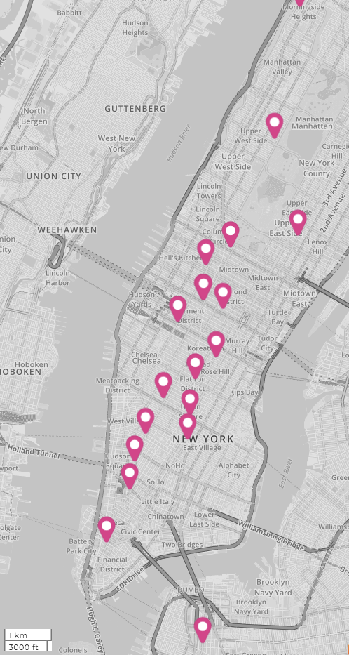
Methodology
Where?
High traffic stations
Closest to tech companies and universities
Notes:
First of all, we’d like to move your teams towards stations that have the largest crowd.
But on top of that, we would also like to find out the overlap of these busy stations with tech-dense areas.

Slide 5
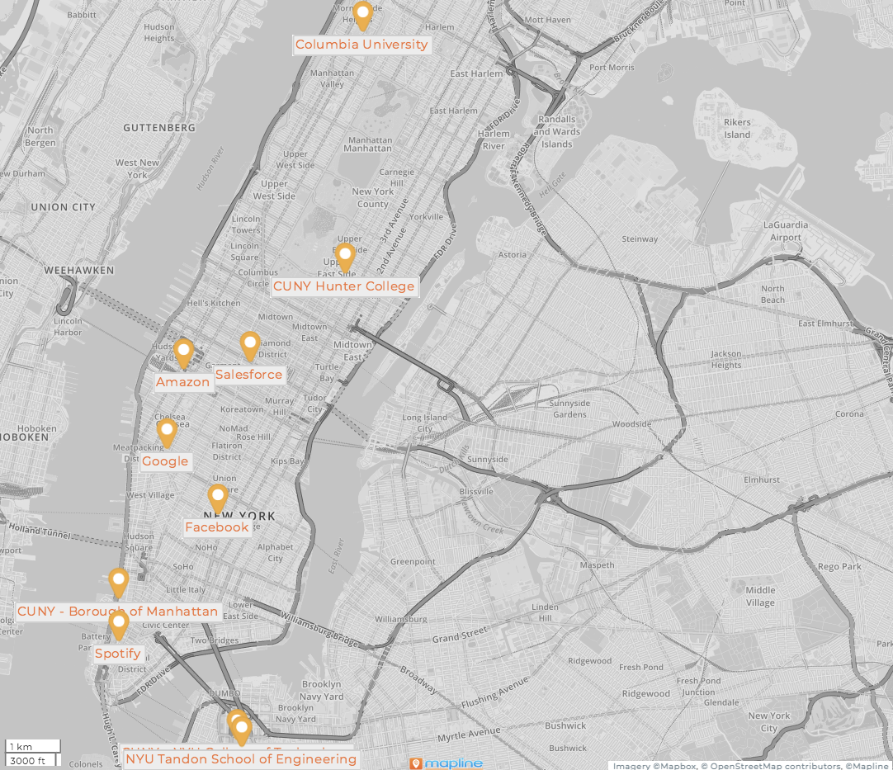
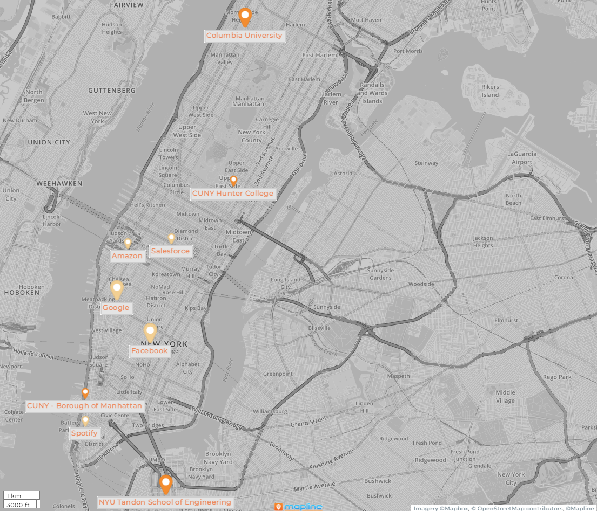










Who loves tech?
Notes:
For this, we have identified the locations of top tech companies and universities in new york city, which is clearly shown in this map on the right.

Slide 6
Methodology
Where?
High traffic stations
Closest to large tech companies and universities
When?
The busiest days
The busiest times of day
Notes:
For the time consideration, we investigate the hourly turnstile data for each station and figure out at what times those stations are the busiest.
We think we’ll be able to set your teams up for success using these dimensions.
And now Aaron will tell you more about the traffic of the mta stations.

Slide 7
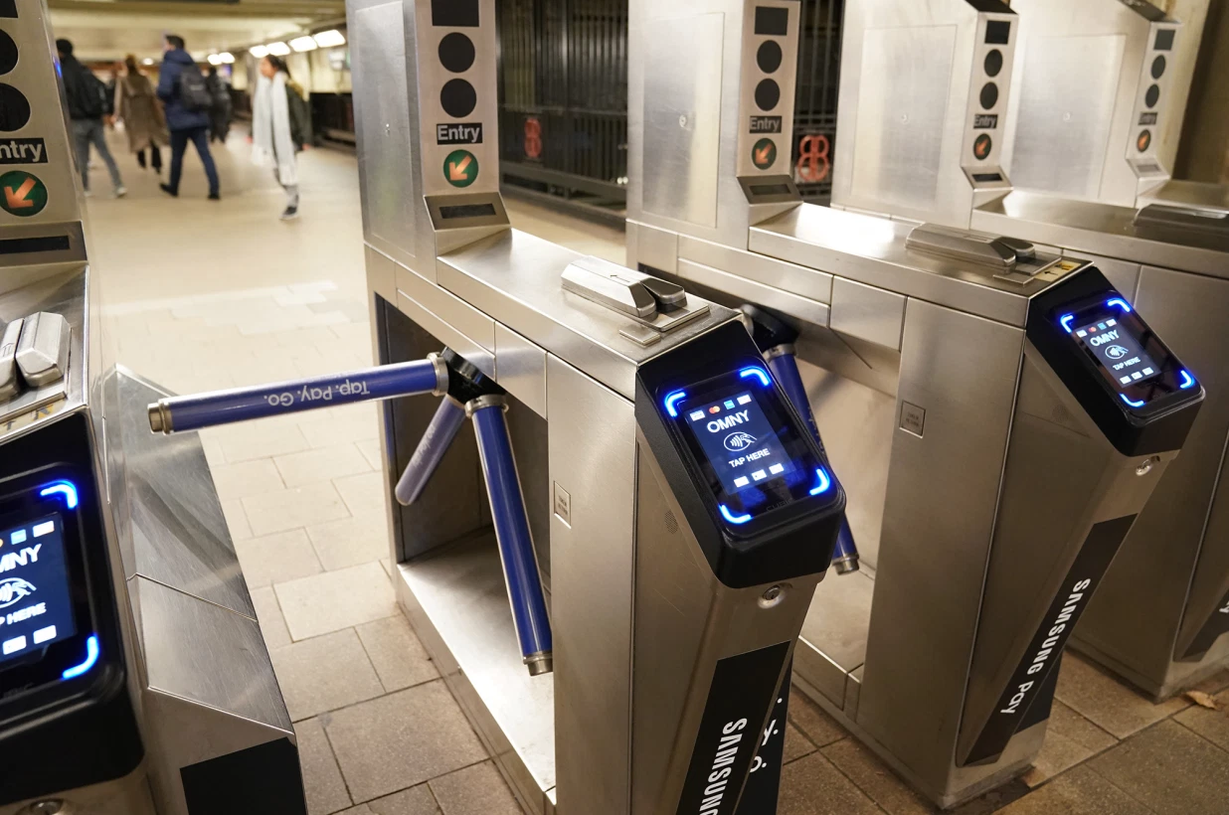
Traffic of MTA Stations
MTA turnstile data for May and June
Traffic = Entries + Exits
Notes:
Can we use pictures on the internet?
https://nypost.com/2020/03/05/mta-ethics-manager-caught-lying-about-hours-misusing-pass/

Slide 8
Top busy stations

Slide 9
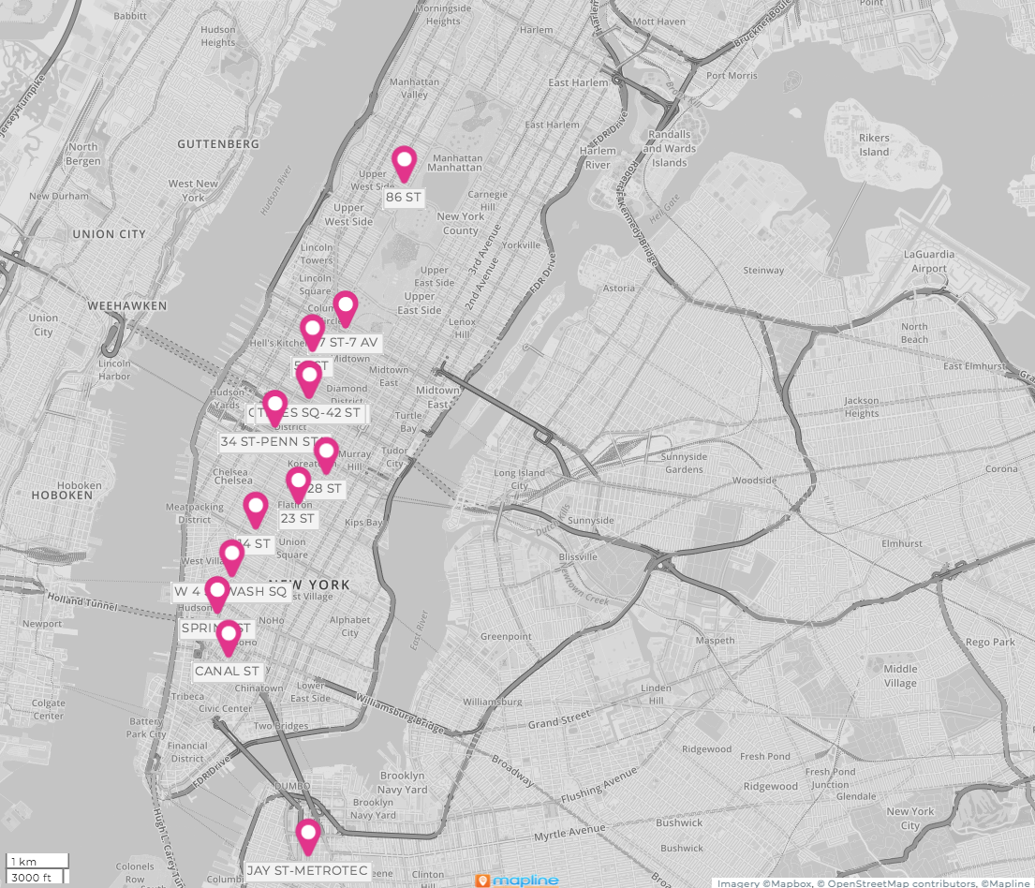
Top busy stations

Slide 10
Our recommendations

Slide 11
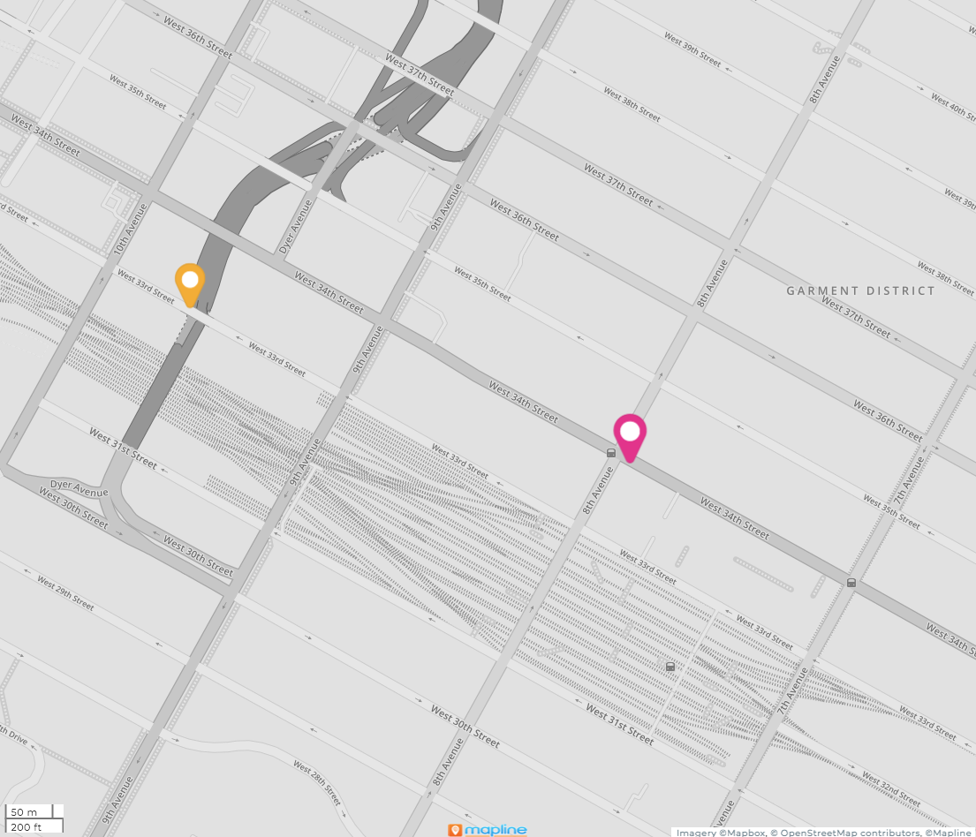
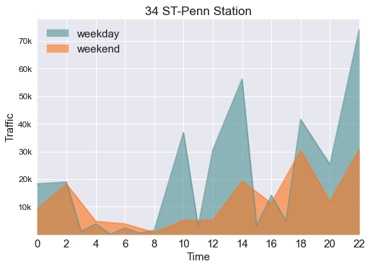
34th St - Penn Station
Tuesday to Thursday 11:30am - 1:30pm
High Traffic
Multiple Amazon locations nearby
Social lunch crowd
34th - Penn Station

Slide 12
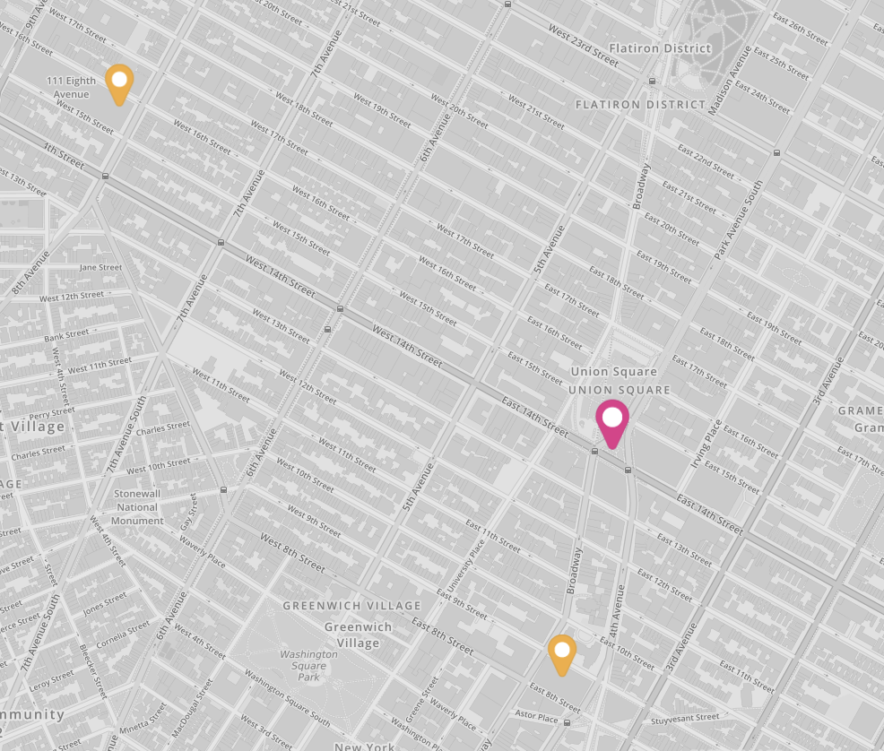
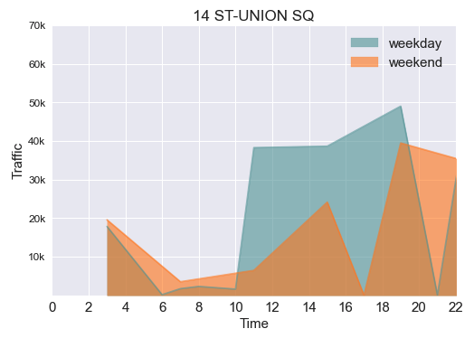
14 St - Union Square
Tuesday to Friday 3:00pm - 7:00pm
High Traffic
Multiple tech companies nearby
14 St - Union Square
Notes:
Tuesday - Friday from
11am - 8pm
3 subway lines / entrances Top 10 Busiest

Slide 13
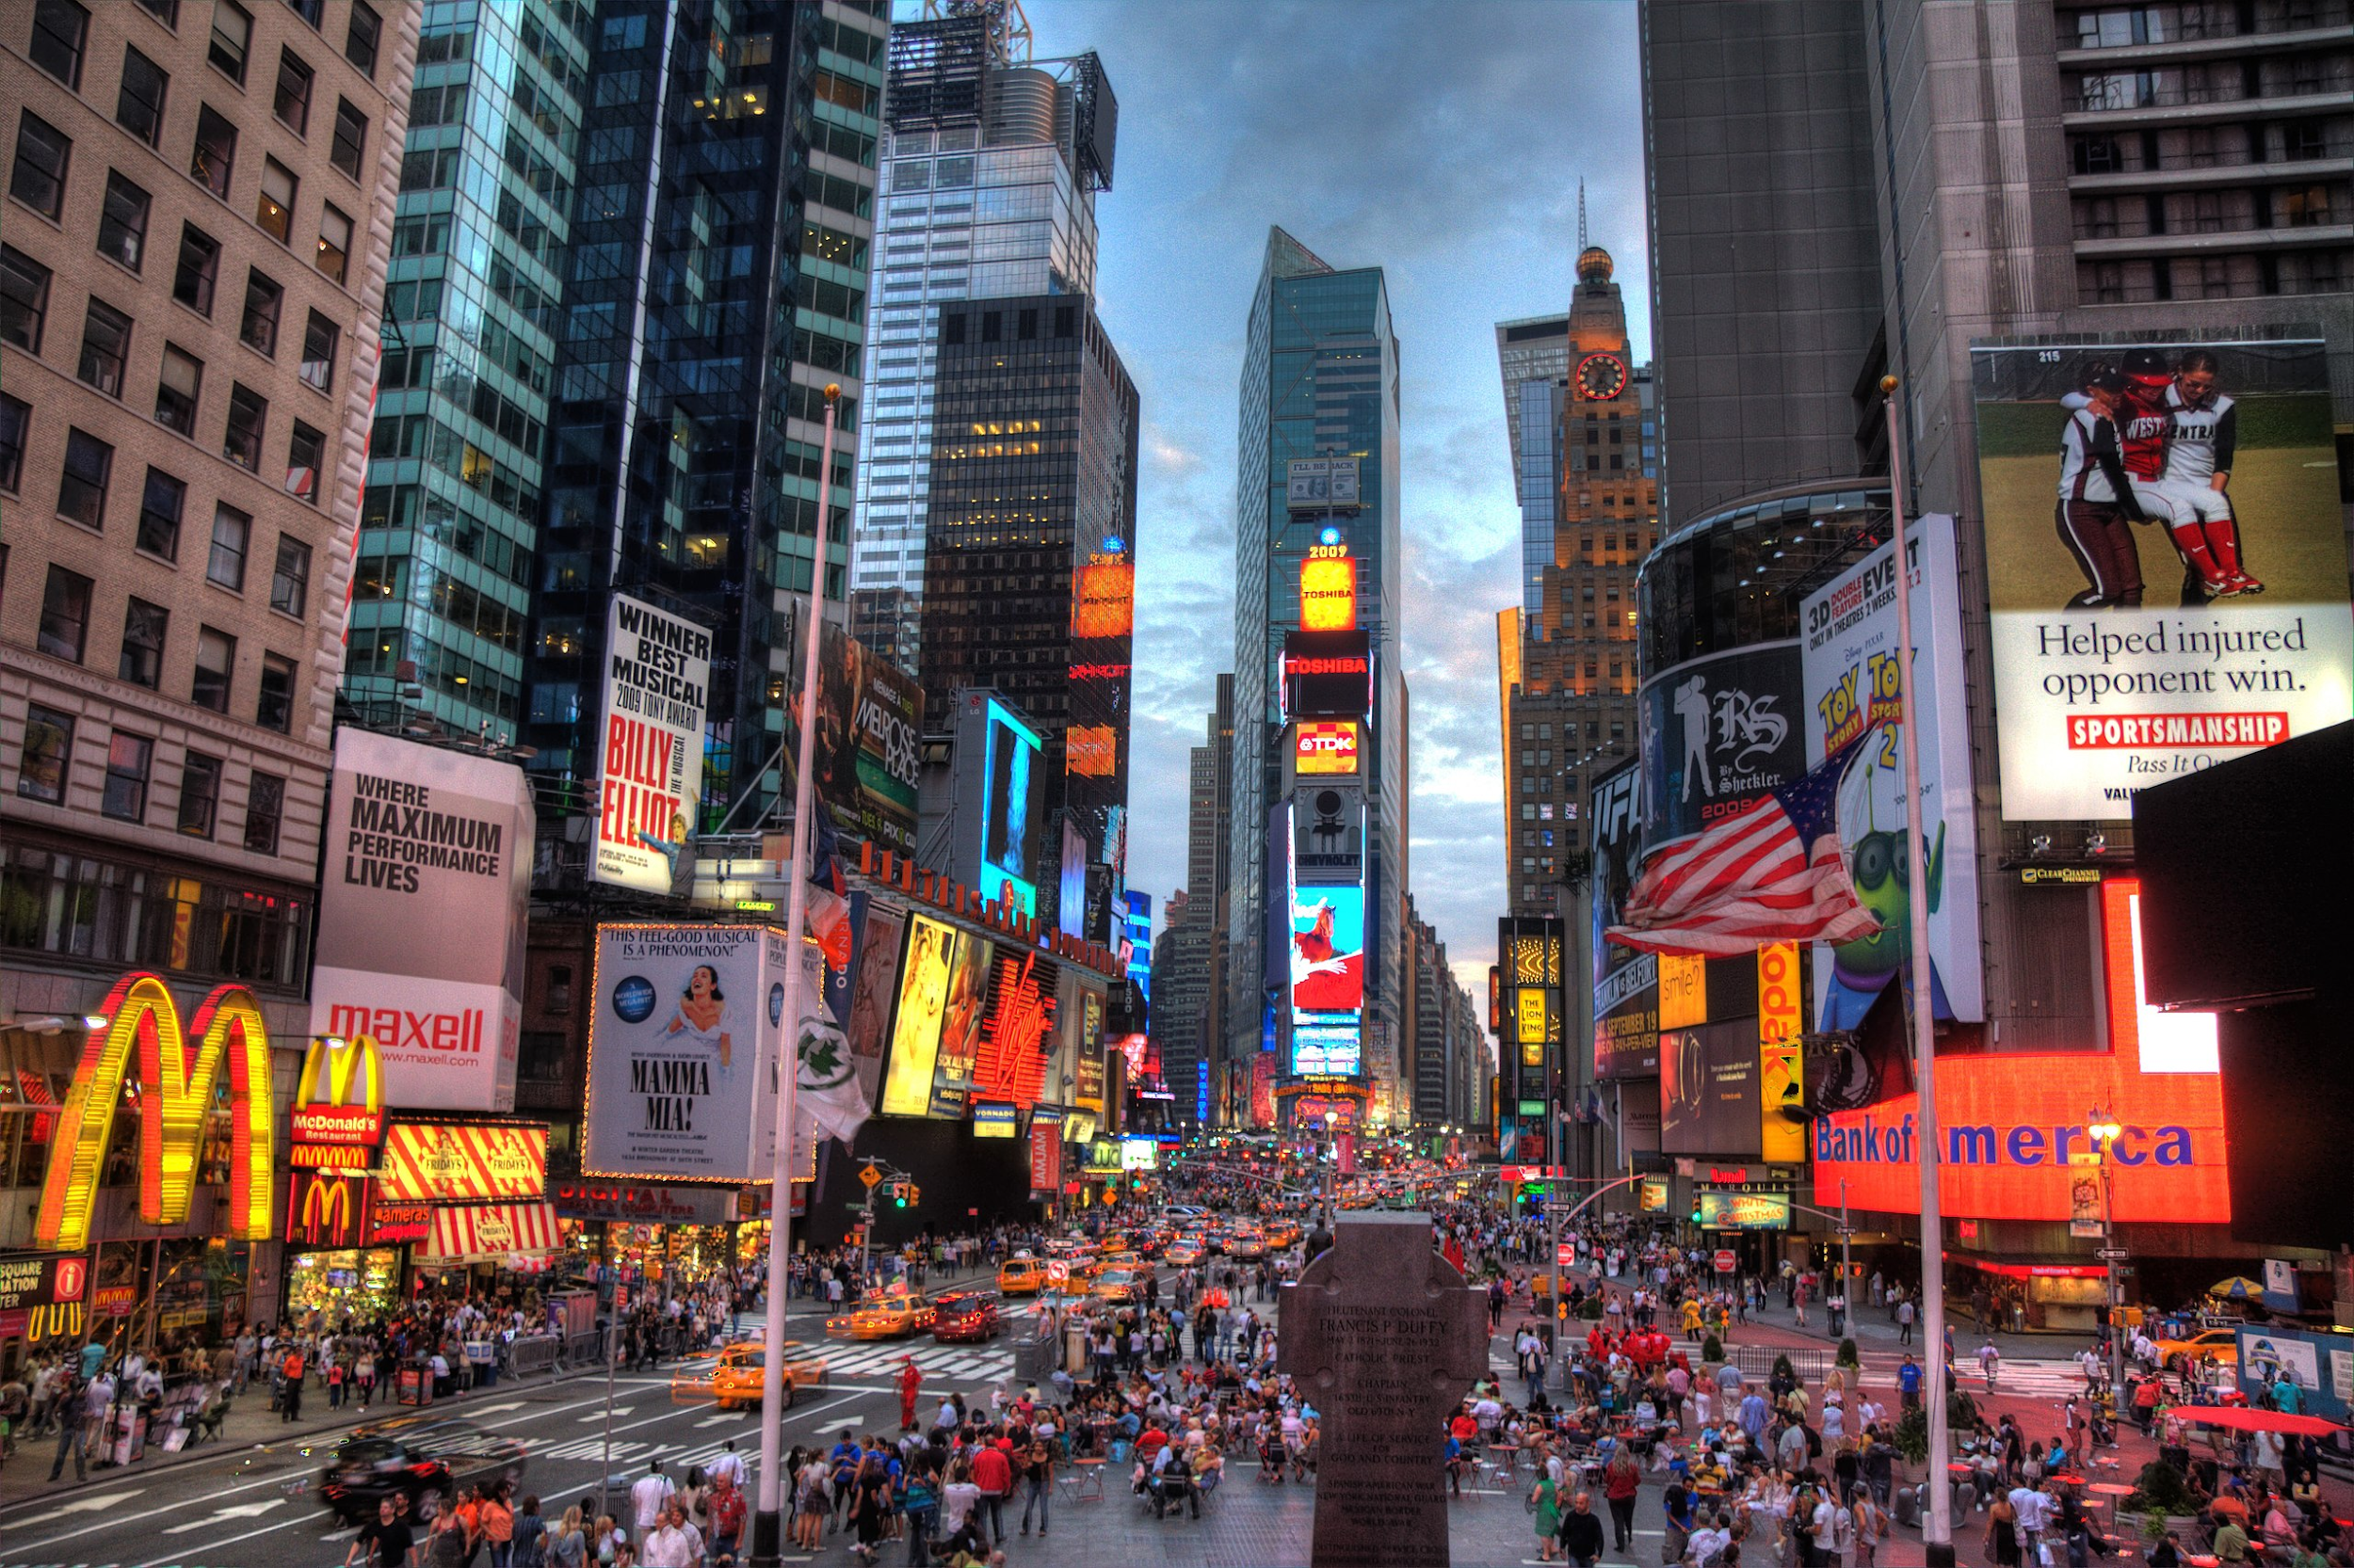
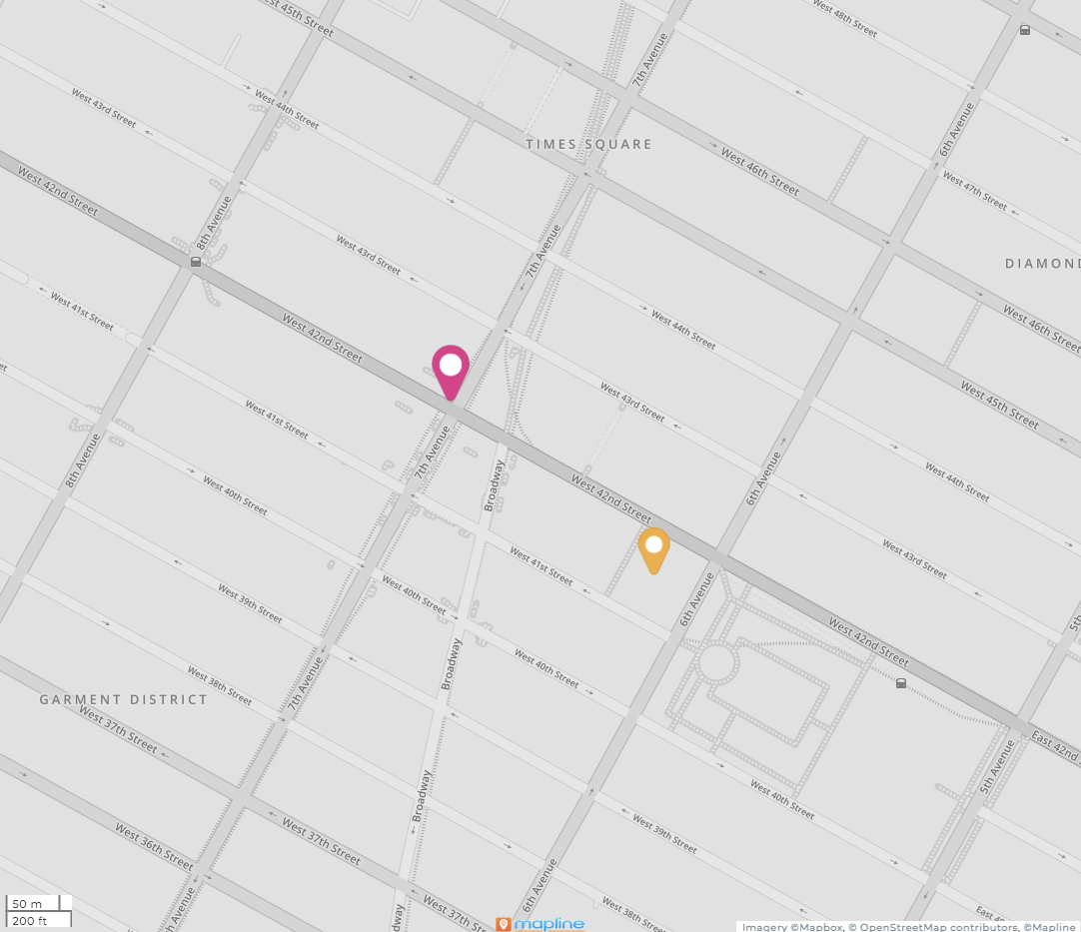
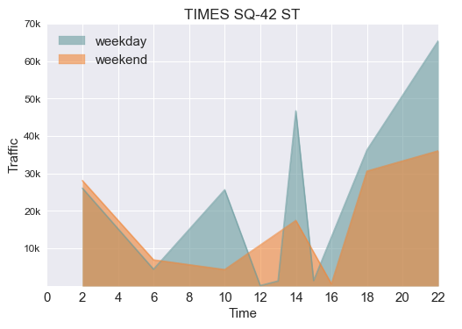

Times Square - 42 St
Tuesday to Friday 3:00pm - 7:00pm
High Traffic
Multiple tech companies nearby
Times Square - 42 St

Slide 14
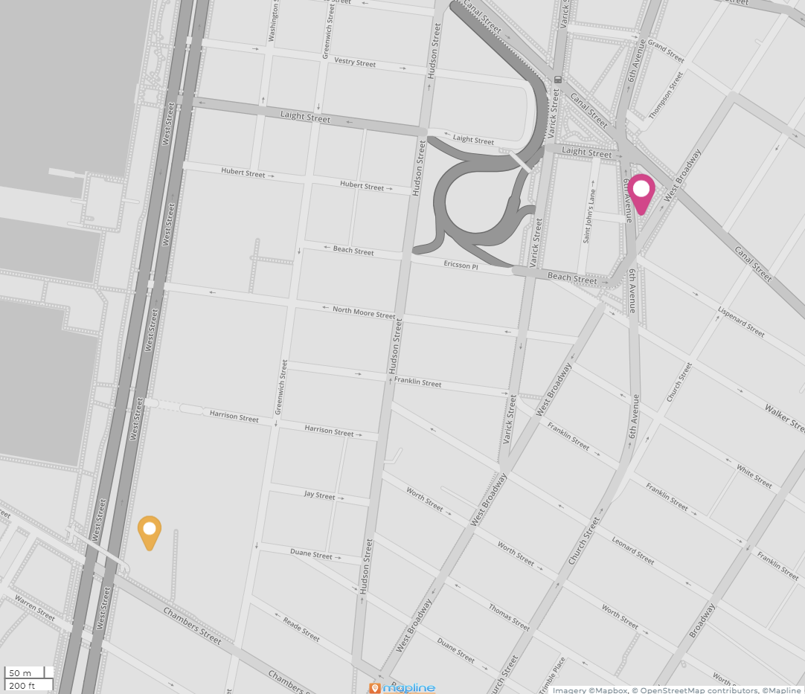
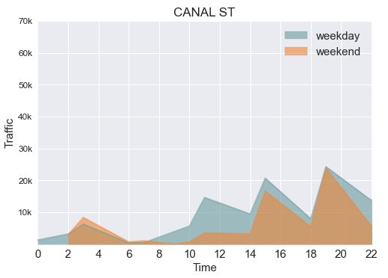
Canal St
Thursday or Friday 5:00pm - 9:00pm
Multiple tech companies nearby
CUNY - Borough of Manhattan
Canal St
Canal St

Slide 15
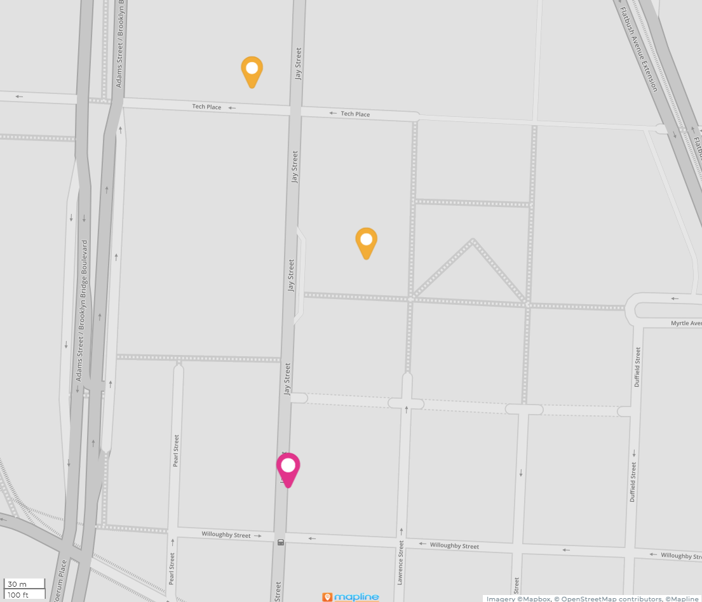
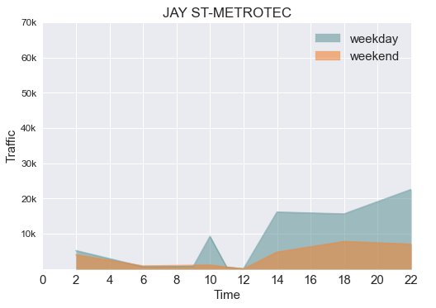
Jay St - MetroTech
Wednesday or Thursday 4:00pm - 8:00pm
City Tech: 17K students
NYU Tandon: 5K students
Jay St - MetroTech

Slide 16
Conclusion
Station Name | Nearby | Street Team
34th St - Penn Station | Amazon | TU, W, TH: Noon - 2pm
14 St - Union Square | Google, Facebook, Adobe, Microcore, Cognito, FlatIron Software, Econify | TU, W, TH, F: 3pm - 7pm
Time Square - 42 St | Salesforce, SoftwareONE, Apple, Gramercy Tech, Domani Tech | TU, W, TH, F: 3pm - 7pm
Canal Street | CUNY - Borough of Manhattan, Spotify and other tech companies | TH, F: 5pm - 9pm
Jay St - MetroTech | NYU Tandon School of Engineering CUNY - NYU College of Technology | W, TH: 4pm - 8pm

Slide 17
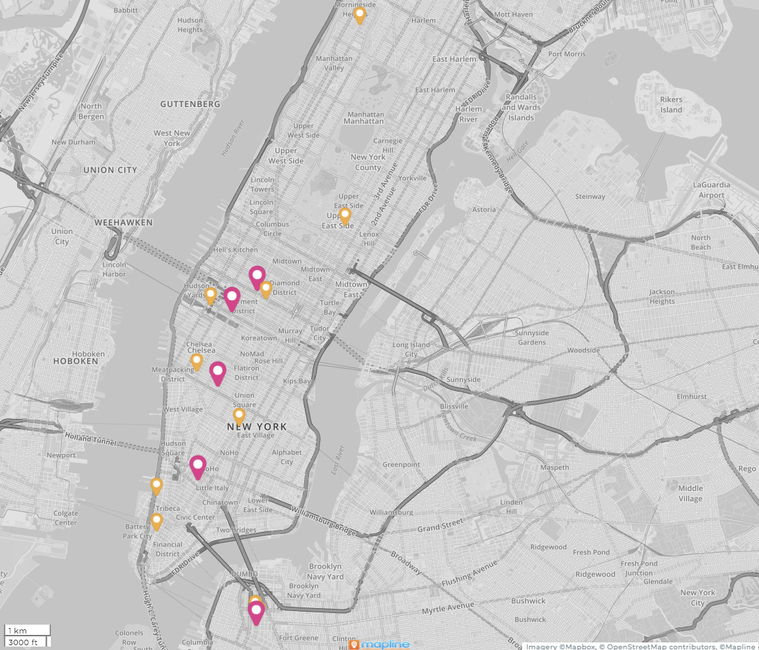
Conclusion
Narrow down to 5 stations near target crowd

Slide 18
Thank you!

Slide 19
Appendix

Slide 20
Data Sources
MTA Turnstile Data for May and June 2018
http://web.mta.info/developers/turnstile.html
MTA Station Information
http://web.mta.info/developers/data/nyct/subway/Stations.csv
MTA Turnstiles-Remote Complex Lookup
https://qri.cloud/nyc-transit-data/remote_complex_lookup
Locations of mta stations and tech companies/universities
Google Maps, Mapline
IRS Individual Income Tax Statistics
https://www.irs.gov/statistics/soi-tax-stats-individual-income-tax-statistics-2018-zip-code-data-soi

Slide 21
Conclusion
Station Name | Entrances | Nearby | Street Team
34th St - Penn Station | 2 | Amazon | TU, W, TH: Noon - 2pm
14 St - Union Square | 3 | Google, Facebook, Adobe, Microcore, Cognito, FlatIron Software, Econify | TU, W, TH, F: 3pm - 7pm
Time Square - 42 St | 4 | Salesforce, SoftwareONE, Apple, Gramercy Tech, Domani Tech | TU, W, TH, F: 3pm - 7pm
Canal Street | 6 | CUNY - Borough of Manhattan, Spotify and other tech companies | TH, F: 5pm - 9pm
Jay St - MetroTech | 2 | NYU Tandon School of Engineering CUNY - NYU College of Technology | W, TH: 4pm - 8pm

Slide 22
Nearest NY MTA Station Stops to Selected
Tech Company | Station Name | Borough
Spotify | Canal St | M
Facebook | Astor Place | M
Salesforce | Times Square | M
Amazon | 34 St-Penn Station | M
Google | 14 St | M
University | Station Name | Borough
NYU Tandon School of Engineering | Jay St-MetroTech | Bk
CUNY - NYU College of Technology | Jay St-MetroTech | Bk
CUNY - Borough of Manhattan | Canal St | M
CUNY Hunter College | 68 St-Hunter College | M
Columbia University | 116 St-Columbia University | M

Slide 23
Subset of Aggregated Federal Tax Returns Filed
We considered income brackets of residents near MTA station stops
Extra income for a night out and to make a voluntary monetary contribution
This a portion of our total aggregated table
Zip Code | Returns Filed > 75K * | Number of Stations | Borough
10023 | 21,990 | 1 | M
11201 | 20,820 | 6 | Bk
10025 | 20,660 | 4 | M
10128 | 19,380 | 1 | M
10016 | 19,140 | 2 | M
10011 | 18,970 | 5 | M
10024 | 18,600 | 4 | M
11215 | 17,710 | 5 | Bk
10003 | 17,270 | 12 | M
*Data Source: https://www.irs.gov/statistics/soi-tax-stats-individual-income-tax-statistics-2018-zip-code-data-soi

